Slide 1

8th Grade Math: Pre-Algebra
Unit 8, Lesson 10 Solving Systems of Equations by Graphing for Real-World Contexts Volume 2, pg. 50

Slide 2


Benchmark
MA.8.AR.4.3
Given a mathematical or real-world context, solve systems of two linear equations by graphing.
volume 2, pg. 50

Slide 3
Integrated Mathematical Thinking and Reasoning Standards
MA.K12.MTR.1.1 Actively participate in effortful learning both individually and collectively.
MA.K12.MTR.4.1 Engage in discussions that reflect on the mathematical thinking of self and others.
MA.K12.MTR.7.1 Apply mathematics to real-world contexts.
volume 2, pg. 50

Slide 4

Learning Target
I can solve a system of two linear equations by graphing given a real-world context.
volume 2, pg. 50

Slide 5

Warm-Up
volume 2, pg. 50

Slide 6
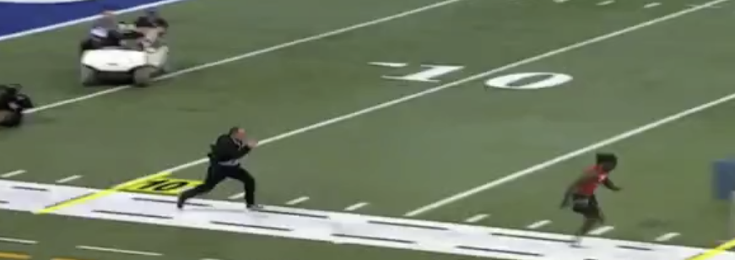

8.10.1 Warm-Up: Notice and Wonder
Julio Jones was drafted to the Atlanta Falcons in 2011. The same year, a video was created showing Rich Eisen, an NFL correspondent, side-by-side with Julio Jones running a $40$-yard dash. A screenshot from the video is shown.
What do you notice?
volume 2, pg. 50

Slide 7
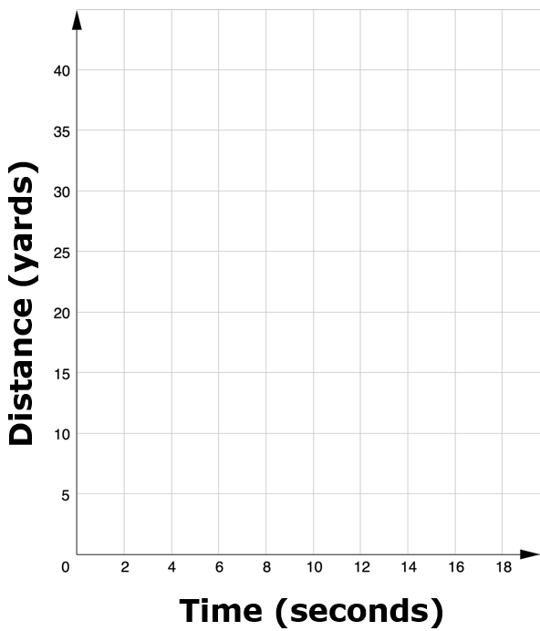
Make a sketch of what you think the graph of the two runners would look like. Be sure to label each line with the name of the runner.
volume 2, pg. 50

Slide 8

Guided Instruction
volume 2, pg. 51

Slide 9
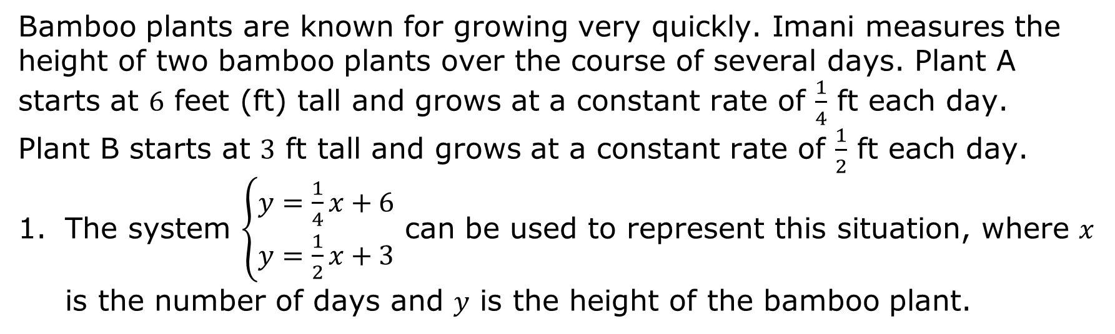
8.10.2 Guided Instruction: Solving Systems of Equations by Graphing in Real-World Contexts
Bamboo plants are known for growing very quickly. Imani measures the height of two bamboo plants over the course of several days. Plant A starts at $6$ feet (ft) tall and grows at a constant rate of $\frac{1}{4}$ ft each day. Plant B starts at $3$ ft tall and grows at a constant rate of $\frac{1}{2}$ ft each day.
The system $\left\{\begin{aligned}y=\frac{1}{4}x+6 \\ y=\frac{1}{2}x+3\end{aligned}\right.$ can be used to represent this situation, where $x$ is the number of days and $y$ is the height of the bamboo plant.
volume 2, pg. 51

Slide 10
Graph the system of equations.
Label the axes with appropriate titles and units.
Label each line Plant A or Plant B.
volume 2, pg. 51

Slide 11
Mark the solution to the system of equations on the graph.
What are the coordinates of the solution?
Explain the meaning of the solution in this context.
volume 2, pg. 51

Slide 12
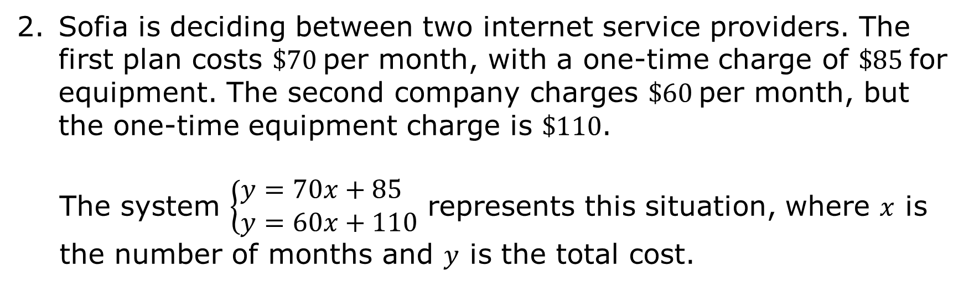
Sofia is deciding between two internet service providers. The first plan costs $\$70$per month, with a one-time charge of $\$85$for equipment. The second company charges $\$60$per month, but the one-time equipment charge is $\$110$.
The system $\left\{\begin{aligned}&y=70x+85 \\ &y=60x+110\end{aligned}\right.$ represents this situation, where $x$ is the number of months and $y$ is the total cost.
volume 2, pg. 52

Slide 13
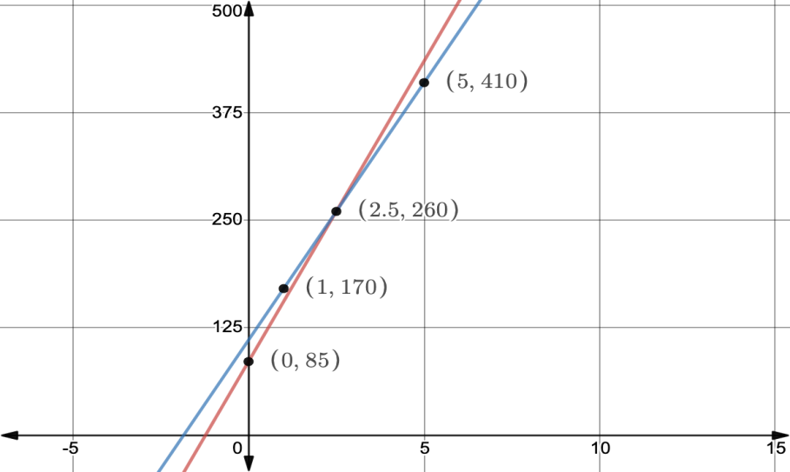
The graph of the system is shown with the coordinates of four points labeled.
What is the solution to the system?
Explain the meaning of the solution in this context.
volume 2, pg. 52

Slide 14

Guided Practice
volume 2, pg. 52

Slide 15

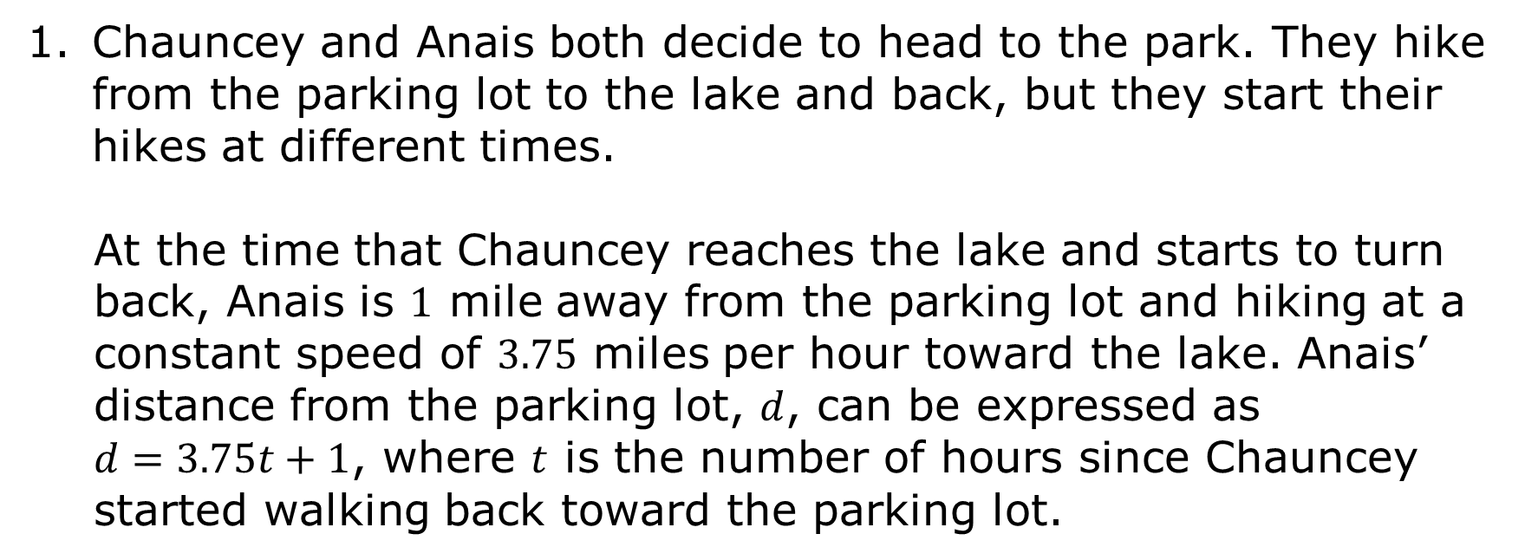
8.10.3 Guided Practice: Solving Systems of Equations by Graphing for Real-World Contexts
Chauncey and Anais both decide to head to the park. They hike from the parking lot to the lake and back, but they start their hikes at different times.
At the time that Chauncey reaches the lake and starts to turn back, Anais is $1$ mile away from the parking lot and hiking at a constant speed of $3.75$ miles per hour toward the lake. Anais’ distance from the parking lot, $d$, can be expressed as $d=3.75t+1$, where $t$ is the number of hours since Chauncey started walking back toward the parking lot.
volume 2, pg. 52

Slide 16
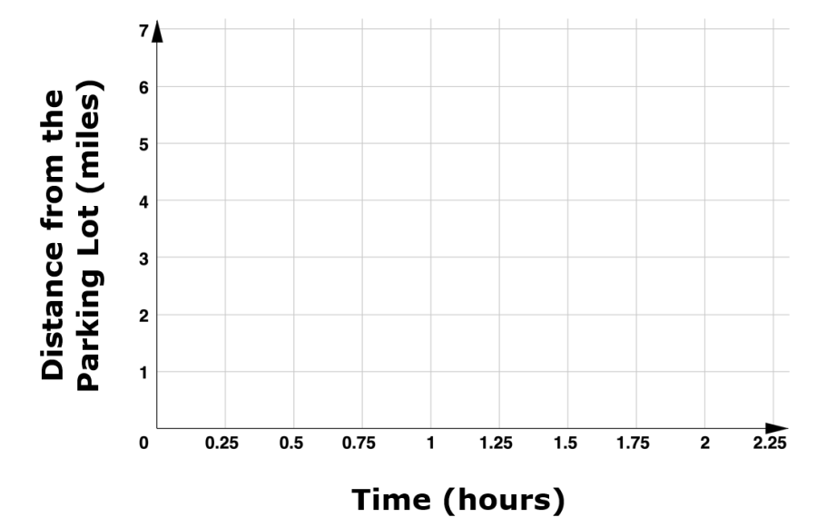

Chauncey’s distance from the parking lot, $d$, can be expressed as $d=−2.25t+5$, where $t$ represents the time, in hours, since he left the lake.
Graph both lines on the coordinate plane.
Label each line as “Anais” or “Chauncey.”
volume 2, pg. 52

Slide 17
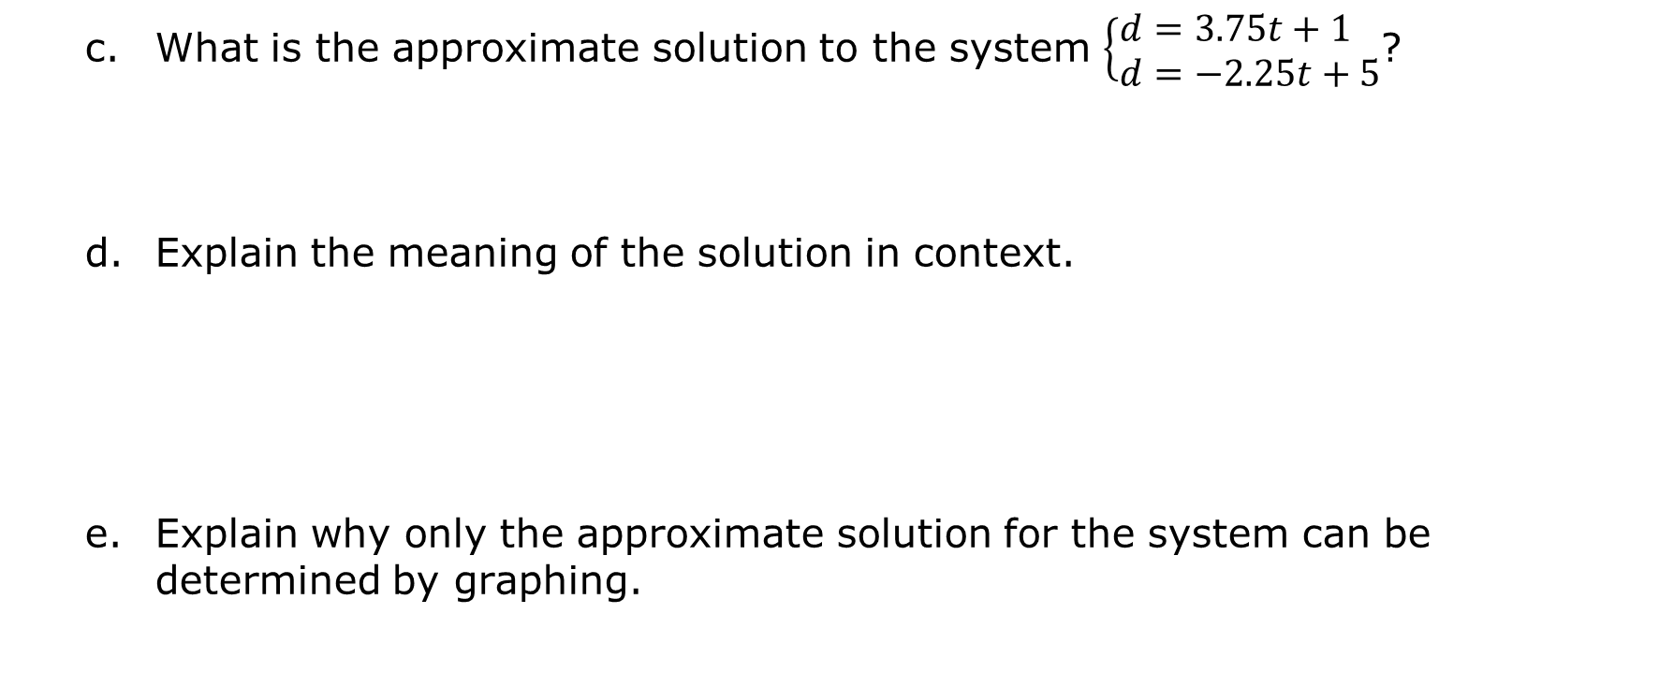
What is the approximate solution to the system $\left\{\begin{aligned}&d=3.75t+1 \\ &d=−2.25t+5\end{aligned}\right.$?
Explain the meaning of the solution in context.
Explain why only the approximate solution for the system can be determined by graphing.
volume 2, pg. 53

Slide 18

Collaboration
volume 2, pg. 53

Slide 19

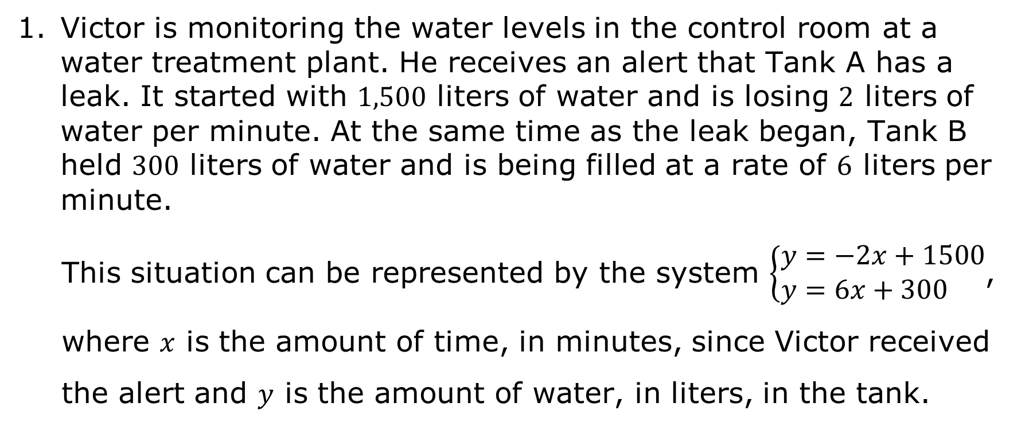
8.10.4 Collaboration: Graphing Real-World Systems
Victor is monitoring the water levels in the control room at a water treatment plant. He receives an alert that Tank A has a leak. It started with $1,500$ liters of water and is losing $2$ liters of water per minute. At the same time as the leak began, Tank B held $300$ liters of water and is being filled at a rate of $6$ liters per minute.
This situation can be represented by the system $\left\{\begin{aligned}&y=−2x+1500 \\ &y=6x+300\end{aligned}\right.$, where $x$ is the amount of time, in minutes, since Victor received the alert and $y$ is the amount of water, in liters, in the tank.
volume 2, pg. 53

Slide 20

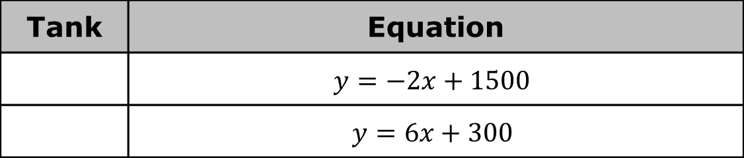
Discuss with your partner which equation represents each tank. Then, complete the table.
Work with your partner to determine how much water will be in each tank $100$ minutes after Victor received the alert.
Tank | Equation
 | $y=−2x+1500$
 | $y=6x+300$
Tank | Volume, in Liters, After 100 Minutes
A
B
volume 2, pg. 53

Slide 21
On your own, graph the system of equations on the coordinate grid.
Label both axes with appropriate titles and units.
volume 2, pg. 54

Slide 22
Compare your graph and labels with your partner and resolve any differences, if necessary.
What is the solution to the system?
Explain what the solution means in this context.
volume 2, pg. 54

Slide 23

Wrap-Up
volume 2, pg. 54

Slide 24

8.10.5 Wrap-Up: Reflection
Take a SELFIE by checking the box that best matches what you did today.
Showed my work
Explained my answers
Lots of math vocabulary used
Found solutions by graphing
I persevered through the problem
Eliminated careless errors
volume 2, pg. 54

